Slide 1

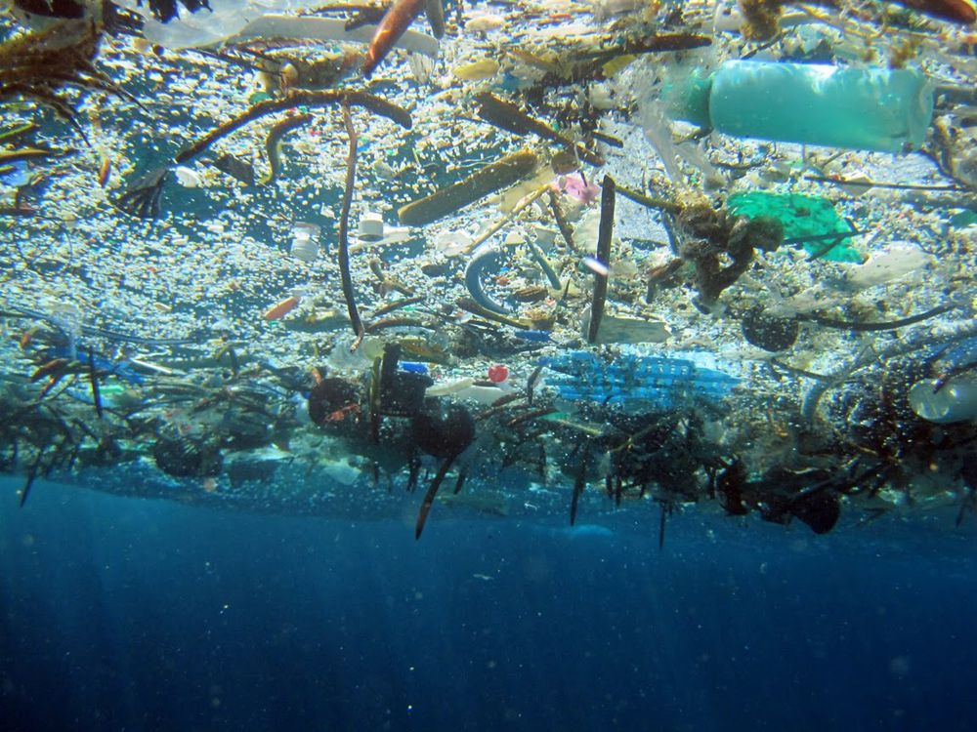
Rebound and Recycle
Incentivizing recycling to reduce waste
Problem
Without a direct incentive, some people may be unwilling to put forth the effort to recycle
Recyclable materials are often wasted and can lead to widespread waste accumulation as seen in the Great Pacific Garbage Patch
Solution
Encourage recycling by making it into a game
Participants will increase a displayed score by adding more recyclables to the bin
Offices and classrooms could award prizes when certain recycling goals are met
Provide educational information to give users a greater understanding of how to get involved in their community
Credit: National Geographic
Final Product
A 100% recyclable, basketball-themed recycling game
RGB LEDs gradually shift from red to green as more weight is added to the bin
Goal weight can be set to any value
Image of final recycling box
Beta Testing
The amount of recycling in a normal recycling bin after two days was compared to the amount in the Rebound and Recycle after two days
Participants in the Forest dormitory were entered into a raffle for a Starbucks gift card once the goal weight was reached
Recycling increased by X amount
Future Directions
Create a more diverse line-up of recycling games that could encourage recycling in a diverse collection of offices and classrooms

